Slide 1

ARDUINO – Day3
BIOE 3090

Slide 2
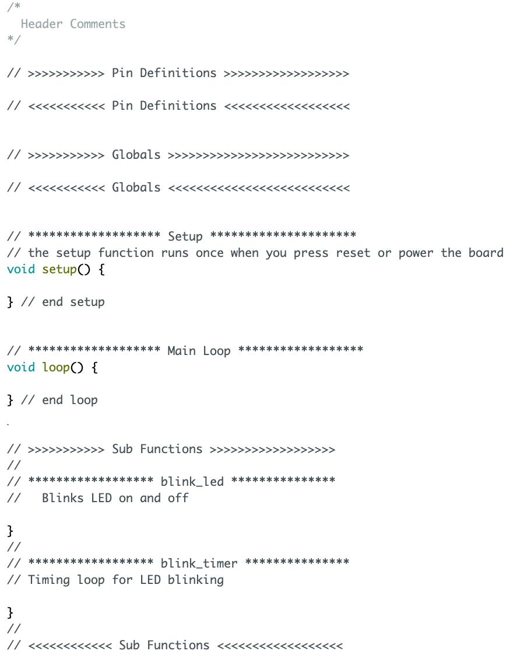
Begin
Pin Definitions
Setup
Loop
Blink_timer()
N
If
Y
blink_led()
Elapsed Time > Switch Time

Slide 3

Activity 5 – Blink_3090 – no delay
Using
currentTime
lastTime
switchTime
ledState
Millis()
Create
Delay()-free timing in main loop
Blink LED

Slide 4
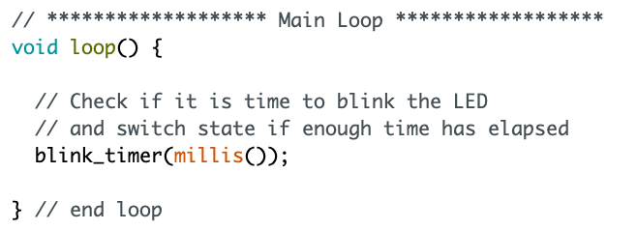
Main Loop
Timing function
Get the current
time & pass to function
blink_timer( millis() )

Slide 5
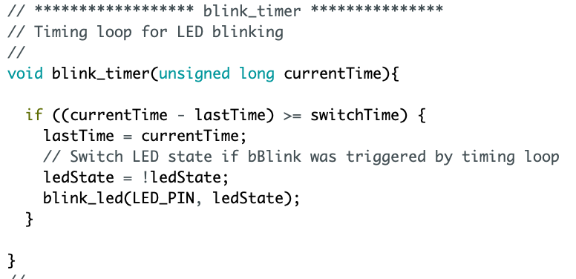
Main Loop
Check if it is time to
blink

Slide 6
Main Loop
Check if it is time to
blink
Flip Bool State

Slide 7
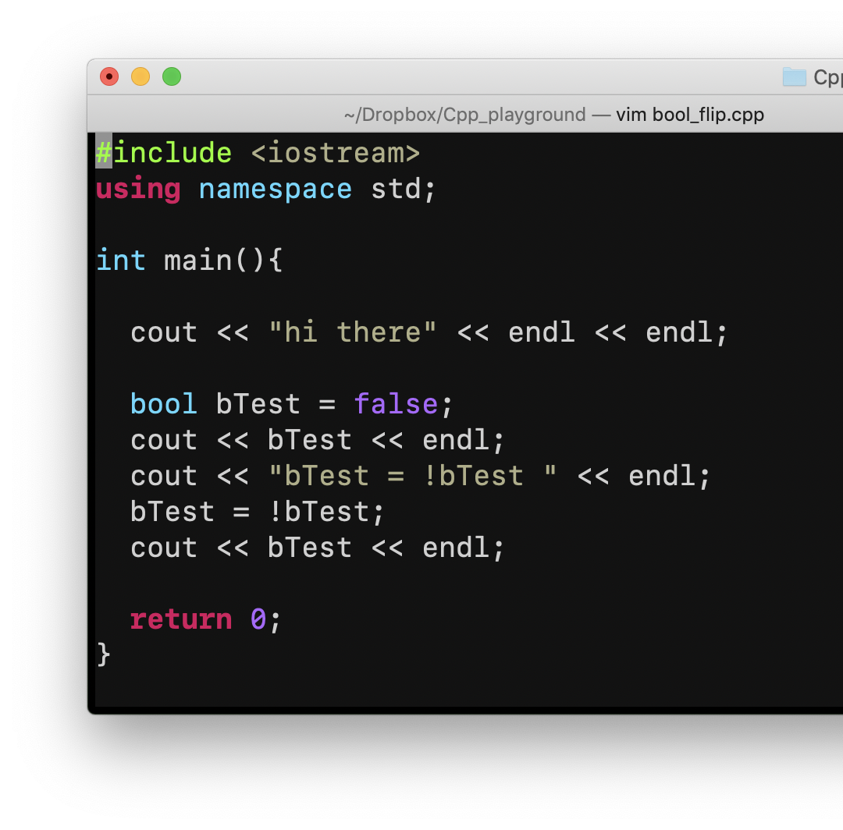
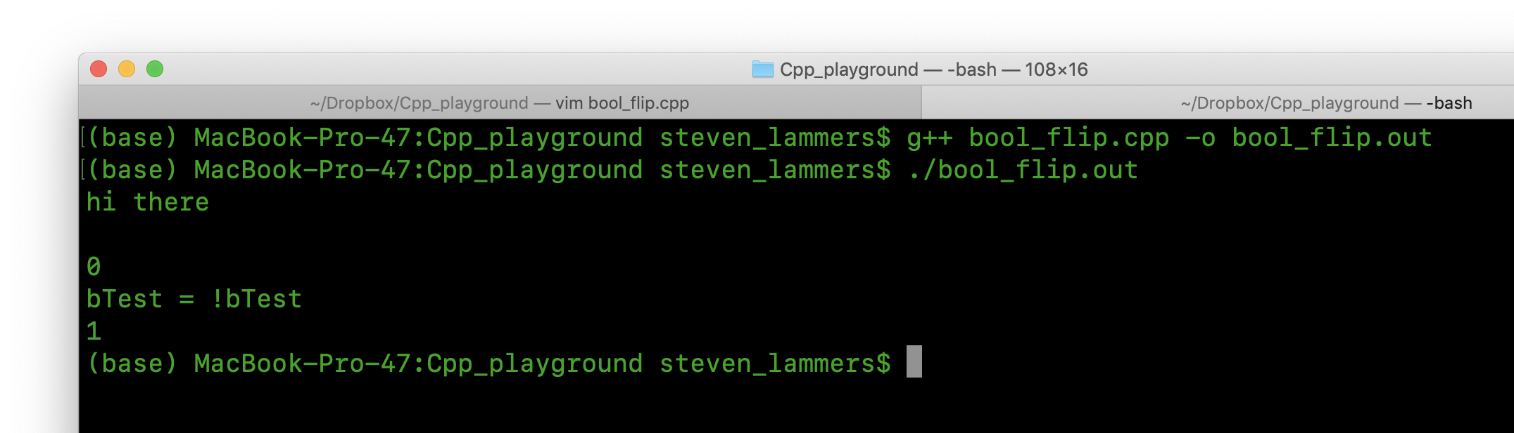
ANSIC Flip Boolean

Slide 8
Main Loop
Important problem
here
Notes:
Millis Rollover

Slide 9
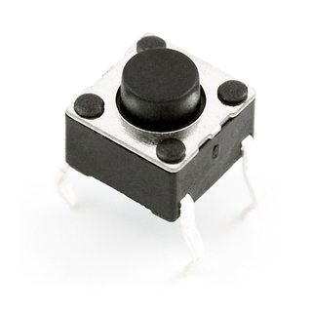
Pushbutton Input
I want a button that starts/stops the LED blinking!

Slide 10
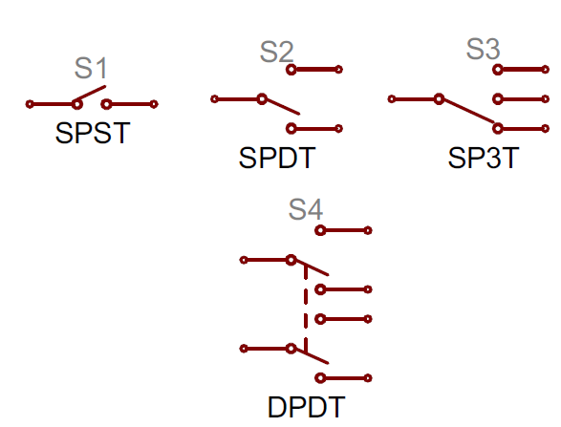
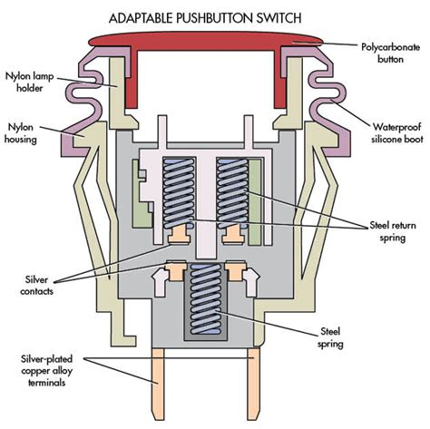
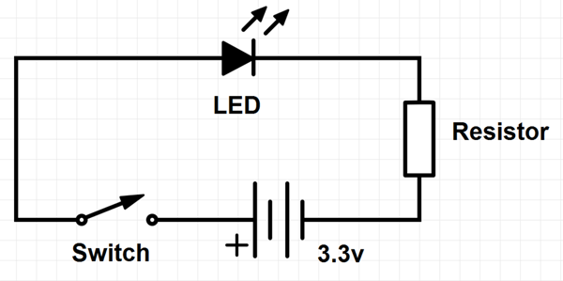
Anatomy of a Pushbutton

Slide 11
Polling – Easy, not great, button state detection
#define PB_PIN 12
pinMode(PB_PIN, INPUT);
bool pbLatch = false;

Slide 12
Activity 6 – Blink_3090 – Polling
Using
PB_PIN
pbLatch – hint: this stores button state
Create
Poll in main loop to latch on/off LED when button pressed
Hint: probably going to want an if statement
Now with Pushbutton Action!!!!

Slide 13
Program Flowchart - Polling
Begin
Loop
Pin Definitions
N
If
Y
pbLatch = false
pbLatch = true
Setup
Pushbutton pressed
Blink_timer()
N
If
Y
blink_led()
Elapsed Time > Switch Time
&& pbLatch == true

Slide 14
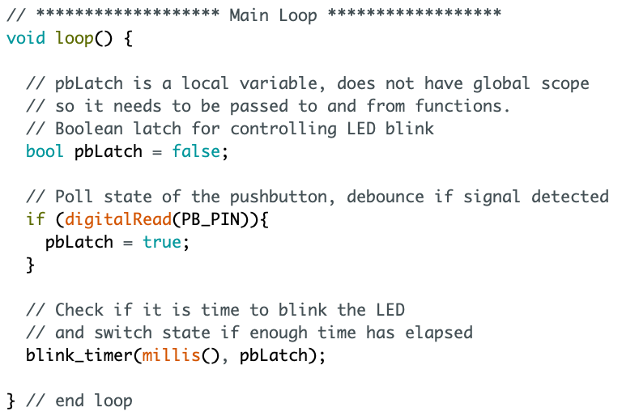
Polling
pbLatch variable
Declared locally
Poll state of PB_PIN
and switch latch
State.
blink_timer now takes
two variables

Slide 15
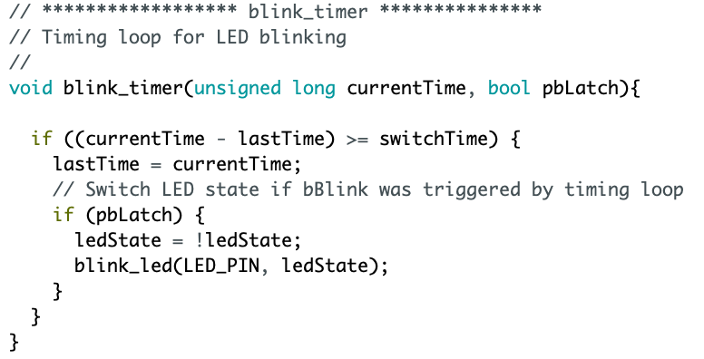
blink_timer - Refactored
Local Boolean
Name does not need to
match with main loop
New if statement

Slide 16
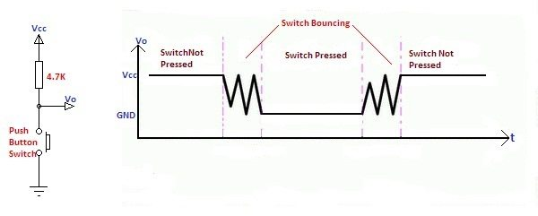
Button Bounce

Slide 17
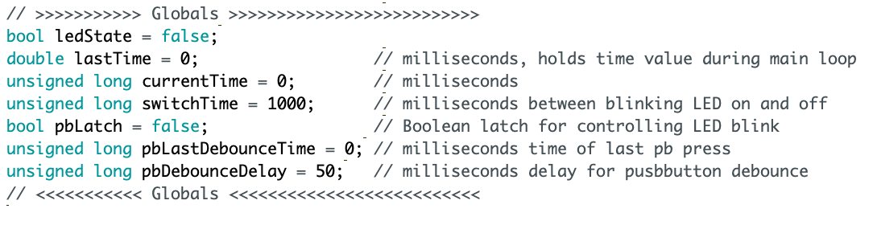
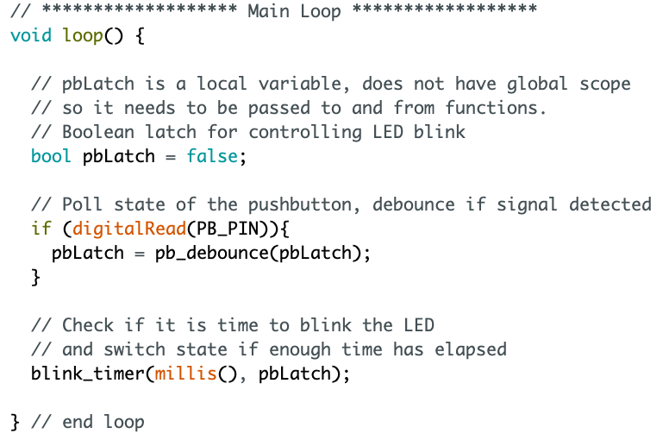
Arduino - Debounce

Slide 18
Activity 7 – Blink_3090 – Debounce
Using
pbLastDebounceTime
pbDebounceDelay
digitalRead()
Millis()
Create
pb_debounce function
Now with Pushbutton Action!!!!

